Slide 1


Slide 2
Principle:1
Base management decisions on a long term philosophy, even at the expense of short-term financial goals

Slide 3
CONTENT
1.TOYOTA 4 P METHOD
2.LONG TERM PHILOSOPHY
3.MISSION POSSIBLE
4.COST CUTTING
5.TYSON treats CHARLIE
6.NUMMI STORY
7.TRUST & MUTUAL RESPECT
8.WALK WHAT YOU TALK
9.SELF RELIANCE & RESPONSIBILITY
Notes:
In the first part, I’ll mention Global Toyota’s today
Then I want to give some information about our company and our invesment experience in Turkey. Finally, I’d like to touch upon the advantages of Turkey and further improvement areas.

Slide 4
Toyota 4 P Method
Problem-solving
(Continuous improvement and learning)
Genchi Genbutsu
Process
Eliminative Waste
(respect & teamwork)
Philosophy (challenge)
(long –term thinking)
People and Partners
(respect, challenge, and grow them)
(respect & teamwork)
4

Slide 5
Toyota 4 P Method
Problem-solving
(Continuous improvement and learning)
Genchi Genbutsu
Process
Eliminative Waste
(respect & teamwork)
Philosophy (challenge)
(long –term thinking)
People and Partners
(respect, challenge, and grow them)
(respect & teamwork)
Adding Value to
Customers & Society
5

Slide 6
Base management decisions on a long term philosophy, even at the expense of short-term financial goals
Principle: 1
Toyota mission:
Contribute to the economic growth of the country in which it is located (external stakeholders)
Contribute to the stability and well being of team members and partners (internal stakeholders)
Contribute to the overall growth of Toyota

Slide 7
Principle One
1
“The most important factors for success are patience, a focus on long term rather than short-term results, reinvestment in people, product, and plant, and an unforgiving commitment to quality.”
-Robert B. McCurry,
former Executive V.P., Toyota Motor Sales

Slide 8
A mission greater than earning a paycheck.
Do the right thing for -
  the company
  its employees
  the customer and
  society as a whole

Slide 9
COST CUTTING
“Base your Management Decision on a Long Term Philosophy, Even at the Expense of Short – Term Financial Goals.”
Does NOT mean
“Don’t Care about the cutting costs”
World War II
Cost Control v/s Cost Reduction.
Waste Cutting v/s Expense Cutting.
Cost Consciousness – down to pennies.

Slide 10
TYSON treats CHARLIE
Doing the Right Thing for Customer Nixon Shock
How Tyson treats Charlie Chaplin is the test of his character.
“The way you treat the customer when you do not owe them anything, like how you treat somebody who cannot fight back – that is the ultimate test of your character.”

Slide 11
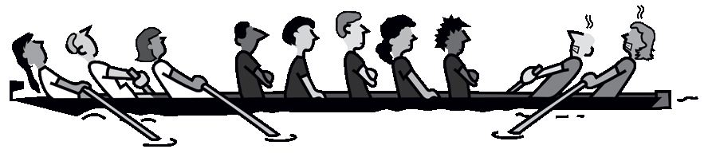
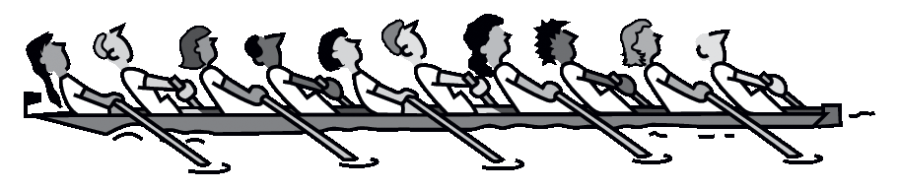
NUMMI story
Building Trust with Employees

Slide 12
“Of all the things Toyota did at NUMMI, that did most to establish trust.”
1980 – First Overseas JV with GM
Local employee union – illegal wildcat strikes.
Toyota took calculated risk to have the “same leaders” in the Shop Committee.
Sent them to Japan and received back “Converted”
Run at 75% capacity BUT didn’t lay anybody off.
Found more useful tasks for them like Kaizen.

Slide 13
Don’t Let Business Decisions Undermine Trust & Mutual Respect Chicken Tax
Maintaining jobs is part of obligation to the community & society.

Slide 14

Walk What You Talk
You can’t just say human resources are important asset; you have to walk the talk every day.
People really watch what you DO, rather than listen to what you say.
Expectations
Complex
Resources
Time
Work-life
balance
Notes:
Has your life become . . .
More or less complex
More or less time
More or less expectations
More or less resources
More or less work-life balance

Slide 15
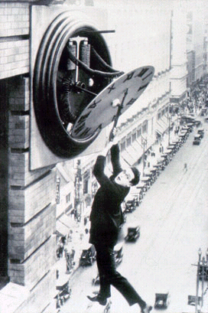
Self Reliance & Responsibility
Let’s do it ourselves!!
Strive to decide your own fate, act with self reliance, trusting in your own capabilities.
Accept the responsibility for your own conduct and for maintaining & improving skills that enable you to produce added value.

Slide 16
Principle:13
NEMAWASHI
Make decisions slowly by consensus, thoroughly considering all options; implement rapidly.

Slide 17
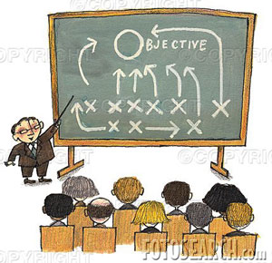

To stand out as the preeminent analyst of the strategy & tactics – Nothing is assumed, everything is verified. The goal is getting it right.
Principle:13
Ask Why in addition to What!!
Challenge conventional assumptions
Focus on Due Diligence & Strategic Planning

Slide 18
Principle Thirteen
13
“For an year-long project ,Toyota will spend 9 to 10 months for planning, then implement in a small way-such as with pilot production-and be fully implemented at the end of the year, with virtually no remaining problems.”
-Alex Warren,
former senior V.P., Toyota Motor Manufacturing

Slide 19
Through consideration in decision making
What is really going on?
Why⁵
Detailed rationale for preferred solution
Consensus within the team
Efficient communication

Slide 20
Set-Based Approach
One of the hardest and the most important lesson Senior Managers at Toyota teach young engineers is to –
DELAY DECISION until a broad array of alternatives has been considered.

Slide 21
Getting on same page!
In the process of decision making many people give input and it generates consensus.
By the time formal proposal comes up for a high level approval, the decision is already made.
Agreements have been reached and the final meeting is a formality.

Slide 22
Alternative Toyota decision making methods.
Preferred
Fallback
Group Consensus, with Full Authority
Group Consensus, Management Approval
Seek Group Input, then Decide & Announce
Level of Involvement
Fallback
(if consensus is not achieved)
Seek Individual Input, then Decide & Announce
Decide & Announce
Time

Slide 23
Communicate visually on one piece of paper.

Slide 24
Plan-Do-Check-Act
Grasp Situation
Plan
Do
Check & Act
Title
Background
(Existing Value, Expectations, Policy, Goal, or Plan)
Current Situation
(Analysis of Need & Contributing Conditions
Recommendations
(Cost/Benefit)
Implementation
(Details of the Plan)
Follow Up
(Expected Results – When/How they will be checked

Slide 25
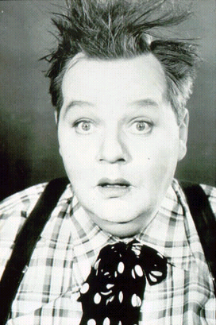
What will be achieved following NEMAWASHI?
It uncovers ALL the facts, that if not considered could lead to a great deal of pain.
Saves from

Slide 26
It feels like this . . .
What will be achieved following NEMAWASHI?
2. It gets all the parties on board & supporting the decision so any resistance is worked out
It saves from this . . .

Slide 27
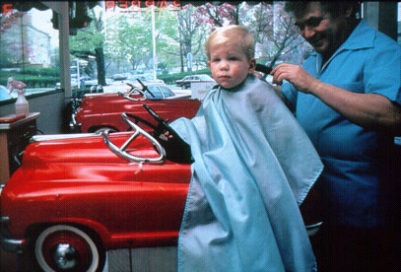
What will be achieved following NEMAWASHI?
3. At achieves a great deal of learning up front before anything is even planned or implemented.
Notes:
Steven Spears
Have seen how it has transformed a company
Interesting – huge resource restraints, terrible domestic market, 50 year late start
Post War Japan – out of the ashes
PDCA – the scientific method – continuous improvement and problem solving cycle
Showed how factory workers
1 million ideas every year
Problem-solving culture – walk in with a “learning” mindset
But it doesn’t translate well

Slide 28
Words of Wisdom
“It is not the strongest nor the most intelligent of the species that survives, but the one that is most adaptable to change”
-Charles Darwin-

